Slide 1

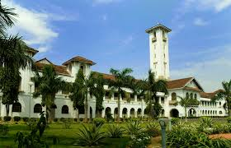
Manas K Mandal

Slide 2
Assistive technology…
Any adaptive device or service that increases happiness, achievement or independence for a person with a disability may be considered assistive technology (AT)
@Manas K Mandal

Slide 3
Why technology does not make us happier
Hedonic adaptation: We adapt too quickly to things that make us happy
Effect size neutralization: pros & cons of technology neutralize impact for each other like social networking to cyberbullying
Sleep deprivation: our need for sleep has not diminished in last 1000 yrs; yet we are losing roughly 2hrs of sleep per day since 1966
Reduced attention: technology encourages externalized attentional process thereby diminish attention internal to self that makes us happy
@Manas K Mandal

Slide 4
Why technology makes handicapped happier
Bridge disparity & bring a sense of independence
Promote growth mind-set & establish an expectation of achievement
Help prevent further impairment & secondary health conditions
Help enter into a society of inclusion & autonomy
“For people without disabilities, technology makes things easier. For people with disabilities, technology makes things possible.” –IBM Training Manual 1991
@Manas K Mandal

Slide 5
Disabled population in India
 | Population | Percentage (%)
Total population | 1,028,610,328 | 100.0
Total disabled population | 21,906,769 | 2.1
Disability rate ( per lakh population) | 2,130 | --
Type of Disability
(a) In seeing | 10,634,881 | 1.0
(b) In speech | 1,640,868 | 0.2
(c) In hearing | 1,261,722 | 0.1
(d) In movement | 6,105,477 | 0.6
(e) Mental | 2,263,821 | 0.2
Source : Census of India 2001.

Slide 6
AT Types
Low tech with little or no training: magnifier, adapted pencil, reading frames
Mid tech with some training: portable word processor, wheel chair
High tech with training: dynamic display communication, high end reading devices
@Manas K Mandal

Slide 7
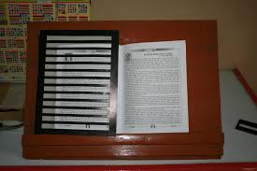
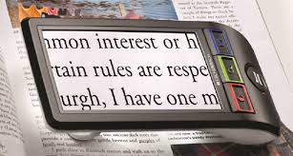
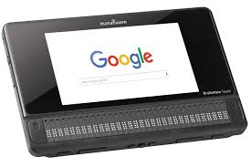
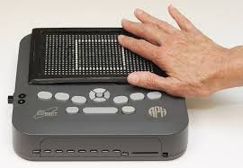

AT for visually handicapped
Non-Optical Low Vision Devices. ...
Optical Devices for Near Viewing. ...
Braille Technology. ...
Tactile Graphics Technology.
@Manas K Mandal

Slide 8
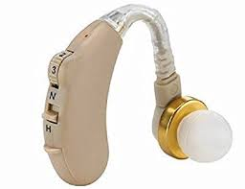
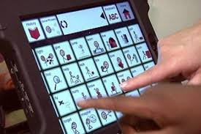
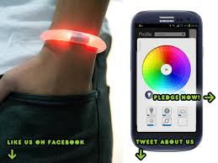
AT for hearing impaired
Assistive listening devices: help amplify sound especially when there is lot of background noise like hearing aid or cochlear implant
Augmentative or alternative communication devices that help people with communication disorder
Alerting device that help people know that an event is taking place
@Manas K Mandal

Slide 9
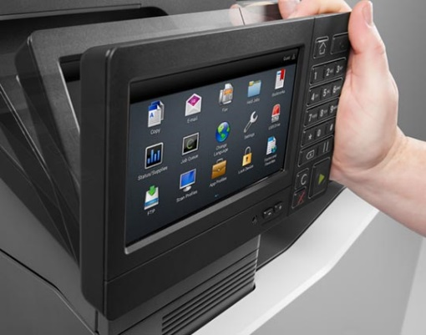
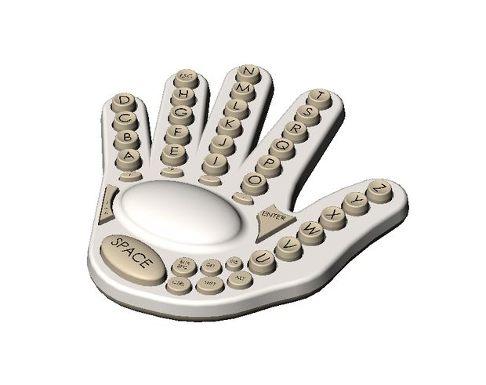
Cognitive solutions by AT
Voice recognition software
Computer with word prediction
Alternative keyboard
Computer with accessibility features
Portable word processor
@Manas K Mandal

Slide 10
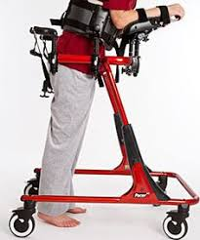
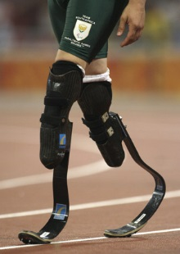
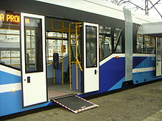
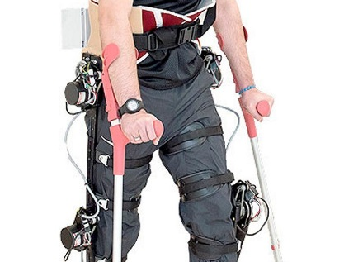
Mobility solutions & accessibility
Gait trainer
Exoskeleton
Prosthetics
Accessibility with universal design
@Manas K Mandal

Slide 11
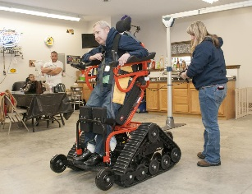
High end AT
Smart glove that automatically translate sign language into a written text
EyeMax system which uses sophisticated eye tracking system to communicate with a screen display
Robotic arm with customizable control and modular components
Hybrid cochlear device that need not be inserted deep into cochlea
Typing braille on on iphone, iBrailler Notes
Stair lift
@Manas K Mandal

Slide 12
Technology development: Rehabilitation engineering
Product Requirements Definition
Prototyping and Design
Software Development
Regulatory Approval
Clinical Testing
Clinical Evaluation
Market Analysis
Transfer to Manufacturing
Business Model Development

Slide 13
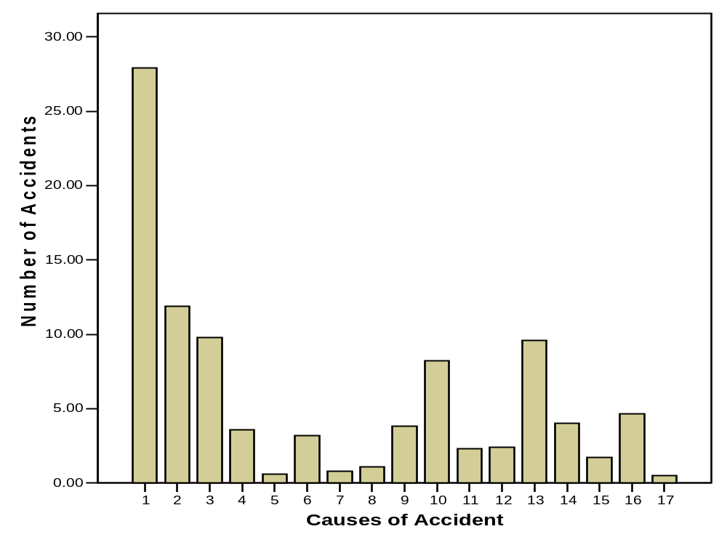

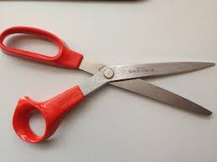
Handling tools (3.2)
Falls (from height) (3.6)
Operation of machinery (9.6)
Operation of automobiles (2.4)
Handling materials/ equipment (27.9)
Dropping tools (0.8)
Falls (on stairs) (0.6)
Operation of hand (trucks) (2.3)
Struck by falling material (11.9)
Stepping on/ striking objects (8.2)
Stumbling & falling (9.8)
Electricity (4.0)
Burns (others) (3.8)
Foreign bodies in eye (4.6)
Burns (acid) (1.1)
All others (4.5)
Gas (1.7)

Slide 14
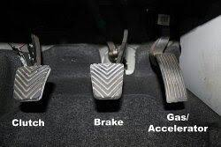
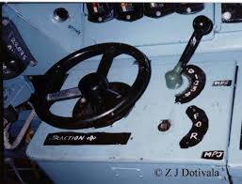
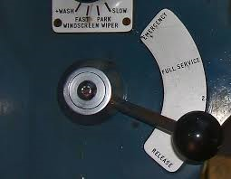
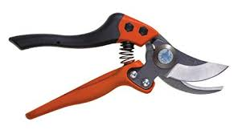
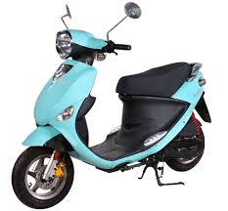
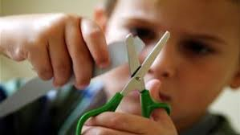
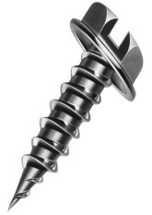
11 April 2008

Slide 15
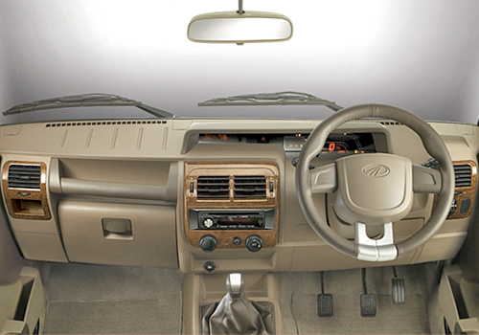
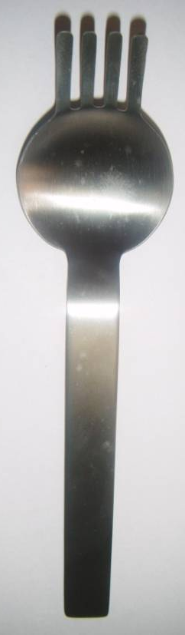
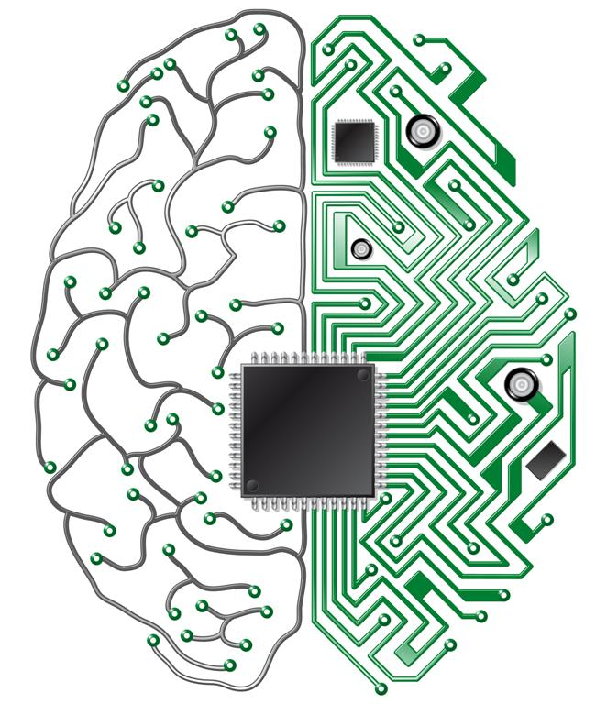
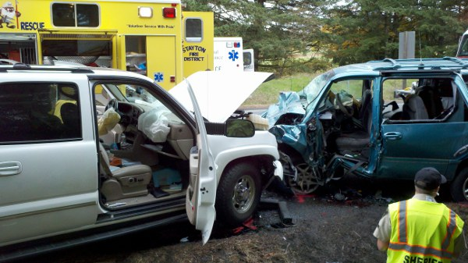
AT for non-clinical population
Do we design machine for right-siders only?
Does commonplace technology foster side bias?
How far tools may be customized?
Can we reduce accident related injuries?
Should the measures of side bias be considered potential for machine design?

Slide 16
Funding opportunities
  National Multiple Sclerosis Society
  Muscular Dystrophy Association
  United Cerebral Palsy (UCP)
  UCP Bellows Fund
  National Dissemination Center of Children with Disabilities
  NICHCY’s Services for Adults with Disabilities
  American Council of the Blind
  American Foundation for the Blind
  RESNA – Rehabilitation Engineering and Assistive Technology Society of North America, India center
  US Department of Veterans Affairs
  Unicef
  DST, Tata consultancy, CSR funds
Notes:
S

